Slide 1

Exploratory Data Analysis
G2M insight for Cab Investment firm
21.05.2022

Slide 2
Agenda
Executive Summary
Problem Statement
Approach
EDA
EDA Summary
Recommendations

Slide 3
Executive Summary
XYZ, a private firm in US, planning to make an investment in
Cab industry since the industry has developed highly in
recent years. Considering multiple key players in the market,
it is following Go-to-Market(G2M) strategy since they want to
understand the market before taking final decision.
Through actionable insights from exploratory data analysis,
the executive team can identify the right company to make
their investment.

Slide 4
Problem Statement
A private firm, XYZ, is planning for an investment in Cab
industry. Before taking final decision, they want to understand
the market. In other words, they want to follow the
Go-to-Market(G2M) strategy to make this investment.
For this, the firm needs to identify the right company to make
their investment.

Slide 5
Approach
1. First, I created the master data by merging the given datasets.
2. Then I explored the master data to understand the features of the dataset.
3. Then I dropped some of the features that might not help me to find the right company for the investment.
4. After that, I used the columns of Price Charged and Cost of Trip to calculate the profit for the master dataset.

Slide 6
Approach
5. Then the “groupby” operation was applied to find the description of the companies. It is obtained that the Price Charged, Cost of Trip and overall Profit gained are comparatively higher for the yellow cabs than the pink ones.
6. I also determined the sum and mean of the features for each cab company. It is obtained that the sum and mean of the features are higher for the yellow cabs than the pink ones due to both popularity and a large number of transactions.
So, it can be decided from the findings that the yellow cabs will be the right company to invest for the XYZ firm.

Slide 7
EDA
After creating the master dataset, I performed a few basic
Exploratory Data Analysis. First, I applied the describe()
method which returns the description of the data in the
DataFrame. Then I displayed the first and last five rows of the
dataset. I applied the shape method to print out the shape of
the DataFrame, which is (440098 X 12) indicating the rows
and columns respectively. To know the layout of each array in
the dataset, I applied dtype method.

Slide 8
EDA
After applying some basic exploratory analysis, I found out
the number of duplicates in DataFrame. It was obtained that,
there is no duplicate row found in the dataset. As a result, the
shape of the dataset remained the same after dropping the
duplicate rows.
After identifying the duplicate rows, I found out the missing
and null values for each features. It was found that there were
some missing or null values for the Date of Travel, Company,
City, KM Travelled etc, in the dataset. Since, the rows with
missing or null values are of no or less importance to find
insights, those rows were dropped. As a result, the shape of
the dataset became smaller, which is (17763 X 12).

Slide 9
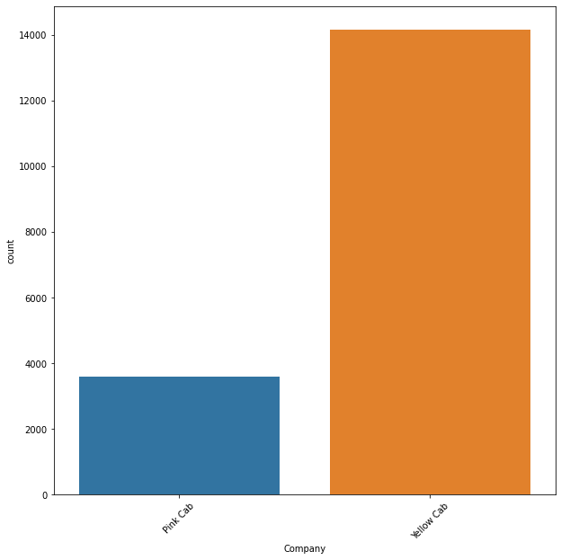
EDA
After the exploring the basic overview of the dataset, the
number of customers of each cab company was counted
using a bar chart.

Slide 10
EDA
Then the number of transactions of each cab company was counted using a bar chart, which was found almost similar as the previous bar chart. The chart shows that the number of transactions occurred for the yellow cab is much higher than the pink ones.

Slide 11
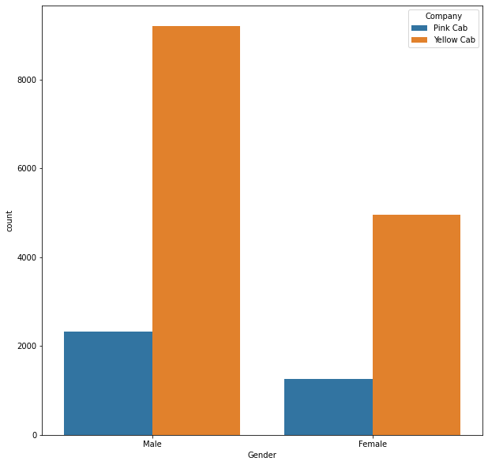
EDA
Moreover, the yellow cabs were popular for both male and female customers.

Slide 12
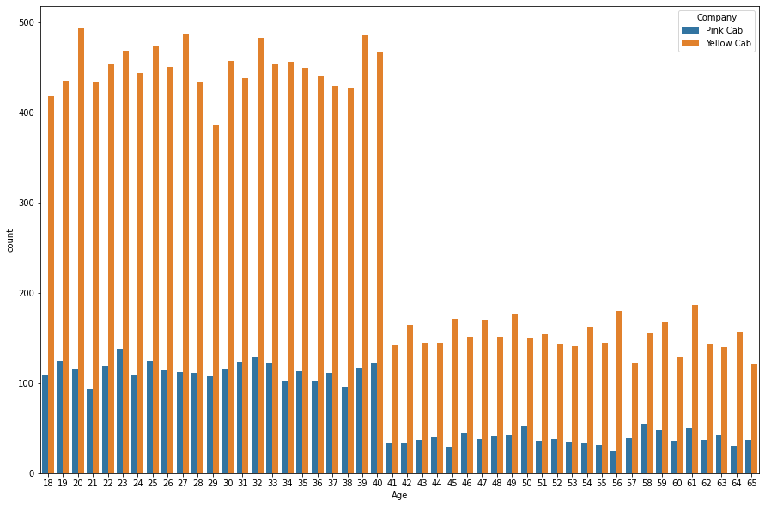

Slide 13
EDA
It was found that yellow cabs were more popular and
commonly used by all age groups of customers.

Slide 14
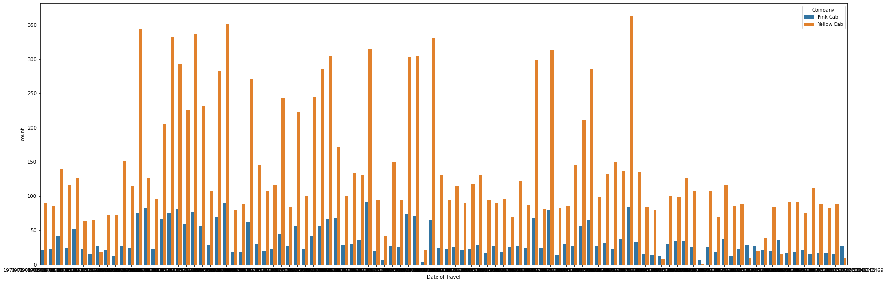

Slide 15
EDA
It was also found that yellow cabs were more popular than the
pink ones during most of the travel dates.

Slide 16
EDA
The popularity between the cab companies were also
obtained for every city in US.

Slide 17
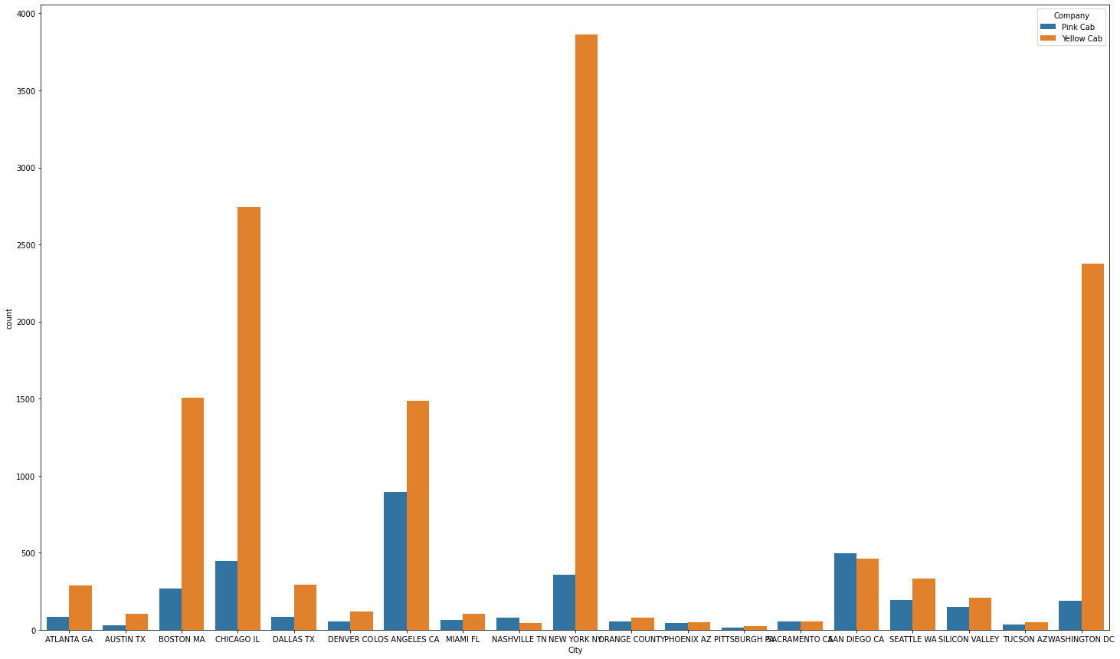

Slide 18
EDA
It was found out yellow cab is more popular than pink cab in
most of the cities in US, though pink cab is insignificantly
popular in San Diego and Nashville.

Slide 19
EDA Summary
In conclusion, it was found that the firm will gain
comparatively higher profit if it makes the investment in the
yellow cab company.

Slide 20
Recommendation
It is recommended to the XYZ firm to invest in the yellow cab
company since the EDA proved that yellow cabs are more
popular and more used by the customers than the pink ones.
It is also obtained that the yellow cab company makes more
profit than the other one.

Slide 21
Thank You

